Slide 1
Compositional Semantics

Slide 2
Principle of compositional semantics
The meaning of a phrase is a combination of the meanings of its constituents, combined in a way determined by the syntactic structure.
It’s got to be right in principle.
It’s awfully hard to get it to work in practice.

Slide 3
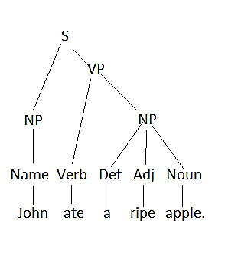
Example
Representation:
Person(p1).
Name(p1,”John”).
Apple(o1).
Ripe(o1).
Event(e1,Eat).
Actor(e1,p1).
Object(e1,o1).

Slide 4
Lexicon
“apple” → Content: Apple
“ate” → Content: Eat
“John” → { Create symbol s.
Assert: Person(s). Name(s,”John”).
Denotation: S }

Slide 5

Compositional rule 1
Given
Apply rule
Denotation(NP) = Denotation(W).

Slide 6
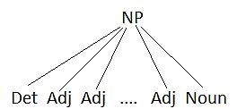
Compositional rule 2
Given
Apply rule
Create a new symbol S.
for (each Adj/Noun P)
assert P.Content(S);
Denotation(NP) = S.

Slide 7
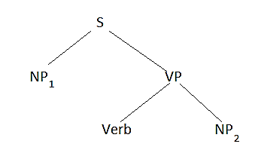
Compositional rule 3
Given
Apply rule
Create a new symbol E. Assert Event(E,Verb.Content)
Assert Actor(E,Denotation(NP₁))
Assert Object(E,Denotation(NP₂))

Slide 8
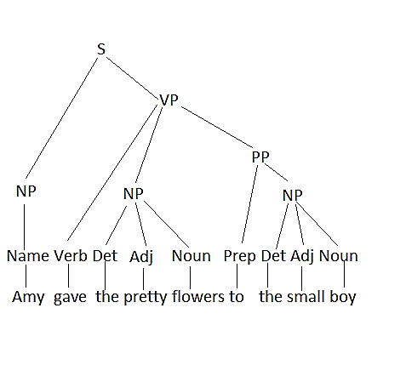
Transference events Programming Assignment 5
Parse tree
Representation
Transfer(X1) Pretty(X2)
Flowers(X2)
Small(X3)
Boy(X3)
Source(X1,Amy)
Destination(X1,X3)
Object(X1,X2).

Slide 9
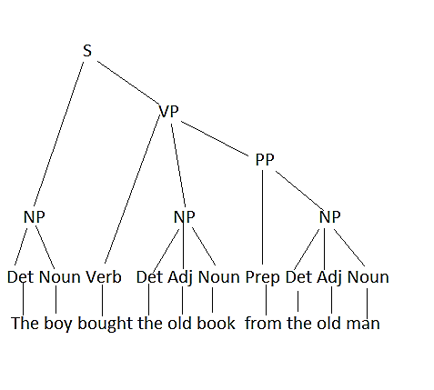
Event example 2
Given
Representation
Transfer(X1). Source(X1,X4). Transfer(X2). Destination(X1,X6). Money(X3). Object(X1,X3). Boy(X4). Source(X2,X6). Book(X5). Destination(X2,X4). Old(X5). Object(X2,X5). Man(X6) Old(X6).

Slide 10
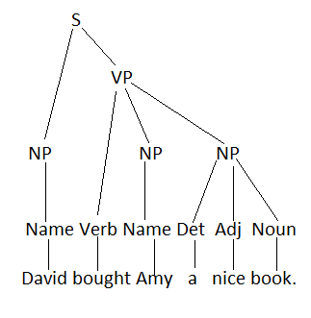
Event example 3
Given
Representation
Transfer(X1). Destination(X2,David).
Transfer(X2). Object(X2,X5).
Transfer(X3). Source(X3,David)
Money(X4). Destination(X3,Amy)
Book(X5). Object(X3,X5)
Nice(X5).
Source(X1,David).
Object(X1,X4).

Slide 11
Parenthesized input of trees
S(NP(Name(Amy)), VP(Verb(gave)),
NP(Det(the), Adj(pretty), Noun(flowers)), PP(Prep(to), NP(Det(the), Adj(small), Noun(boy))))).

Slide 12
Text interpretation
Reference resolution. Determine how objects in one sentence relate to objects in a different sentence.
Textual structure. Determine the connection between one sentence and another
Discourse structure in conversation
Causal structure in narrative.
Argument structure in expository writing
…

Slide 13
Example: Text
John bought two oranges at the store yesterday. When he got home, he found that they were moldy. He brought them back and demanded his money back.

Slide 14
Events
E1: John purchases two oranges for $X$ from the store. Time T1.
E2: John gives $X to the store employees. Time T1.
E3: A store employee gives the oranges to John. Time T1.
E4: John eats the oranges (hypothetical).
E5: John goes home, taking the oranges. Time T2.
E6: John discovers S2. Time T3.
E7: John goes to the store, taking the oranges. Time T4.
E8: A store employee give $X to John (hypothetical).
E9: John tells a store employee that he/she must carry out E8. Time T5.

Slide 15
Key states for causal structure
S1: John owns the oranges. After T1 through T5.
S2: The oranges are moldy. All times.
S3: John is at the store. Time T1, T5.
S4: John has regained the $X he paid for the oranges. Hypothetical

Slide 16
Causal connections
E1: John purchases two oranges for $X$ from the store. Time T1.
E2: John gives $X to the store employees. Time T1.
E3: A store employee gives the oranges to John. Time T1.
E4: John eats the oranges (hypothetical).
E5: John goes home, taking the oranges. Time T2.
E6: John discovers S2. Time T3.
E7: John goes to the store, taking the oranges. Time T4.
E8: A store employee give $X to John (hypothetical).
E9: John tells a store employee that he/she must carry out E8. Time T5.
Sequence(T1,T2,T3,T4,T5). Subevent(E2,E1). Subevent(E3,E1). NeededFor(E1,E2). NeededFor(E1,E3). NeededFor(E2,E1). NeededFor(E3,E1). Result(E1,S1). Precondition(S1,E4). Cancels(E5,S3). Goal(John,E4). Time T1 until T5. MakesImpossible(S2,E4). Goal(John,S4). Time T5 through end. Result(E7,S3). Precondition(S3,E9). PossibleResult(E9,E8). Result(E8,S4).

Slide 17
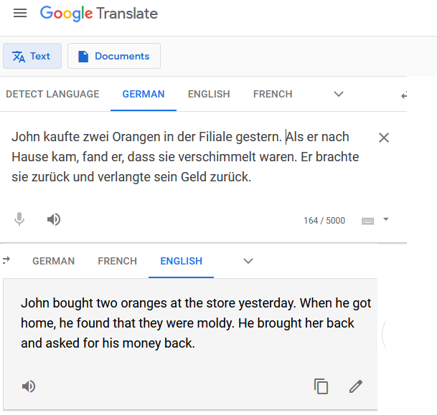
Google Translate (11/24/20)

Slide 18
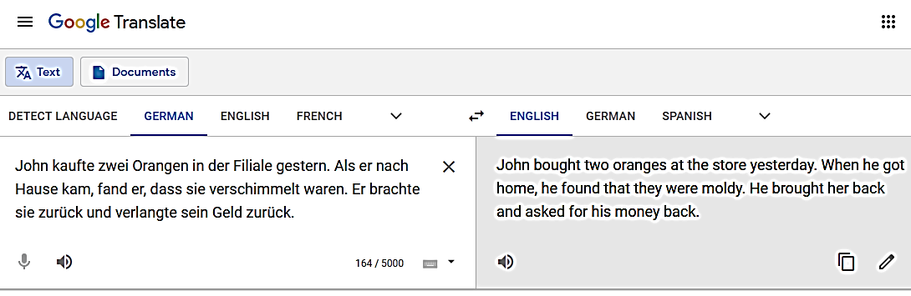
Significance for translation

